Slide 1
18ECO134T – Sensors and Transducers
Unit III : Session 3 : SLO 1
SRM Institute of Science and Technology
Notes:
Pl use Font Family : Arial Narrow
To enhance the teacher presentations and the overall comprehension of students, it allows to present their lessons in a more dynamic and effective way. Set a Learning Objective:
1. Write an Outline for Key Ideas
2. Give the Presentation About Education a "Why"
3. Share Techniques and Tips for the Topic
4. Teach With Visualizations
5. Use Animations Carefully

Slide 2
Materials for thermos-emf sensors

Slide 3
MATERIALS FOR THERMO-EMF SENSORS
Materials for Thermoemf Sensors
Material choice is guided by quite a few important factors:
(a) high thermoemf per unit temperature change, that is high thermoelectric power.
(b) low electrical resistance of the couple.
(c) linearity of E-T curve over the range of Interest.
(d) high melting point of the couple materials for wider range,
(e) material should be available as pure and homogeneous, workable in desired shapes and should not be easily contaminable.
(f) should be usable over king period of time without getting brittle. or acquiring scales. or change of composition (for alloy type materials).
(g) should be properly annealed to make it free from Mains/stresses produced during cold drawing process.

Slide 4
Elemental materials listed by Seebeck are not all suitable for commercial pairing to form thermocouples. Throe categories of thermocouple do mist in practice. namely
the base metal type consisting of couple members made of elemental base metals or alloys thereof.
the noble / Precious metal type made from noble metals or alloys thereof. and
nonmetallic types.
Thermocouples are usually Identified by capital letters of the English alphabet. The base metal types are identified by letters E, I, K, N, and T; and the noble metals thermocouples are identified by G, C, D, B, R, and S. Nonmetallic thermocouples are special kind and will be considered separately.
Several countries have included this standardized nomenclature providing temperature range, tolerance, service. (intermittent or continuous) and quality (standard or special). International Electrotechnical Commission (IEC) publication 584 with various parts (1, 2, 3) is such a standardizing document. Table 3.9 shows a specification sheet of the various types of couples.

Slide 5
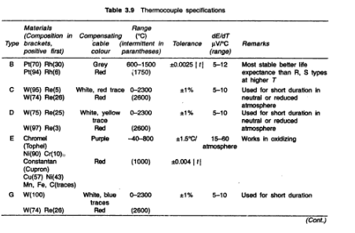

Slide 6
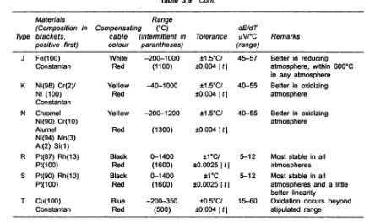

Slide 7
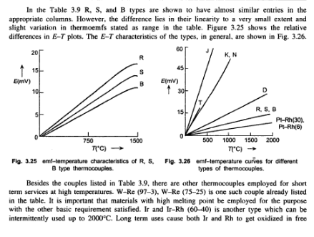

Slide 8
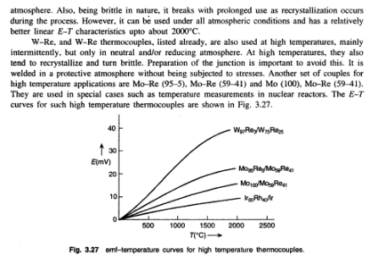

Slide 9
